Slide 1
Fra Bondegrupper til bondeforeninger – kapacitetsudvikling af danske civilsamfundsorganisationers arbejde med udvikling og konsolidering af bondeforeninger
De deltagende organisationer ønsker at styrke deres arbejde med udvikling af bondeforeninger i Syd, så de udvikles til demokratiske og bæredygtige civilsamfundsaktører, der kan sikre medlemmernes adgang til basale rettigheder. Det afgørende er at bøndernes organisering bevæger sig fra gruppe til foreningsniveau, hvis bæredygtigheden skal sikres

Slide 2
Danish CBOs lacked knowledge about:
The role their partners play in relation to the local authorities? How is the relationship?
How to move from group with individual marketing to federations with common marketing?
How to develop management skills, and more specifically how to practice responsibility and transparency in relation to the members?
How to ensure institutional sustainability?
Indicators that can help partners and CSOs (civil society organizations) to measure on the processes the partners go through to be able improve on our support.

Slide 3
Monitoring workshop - Group work - Amolatar

Slide 4
A successfull democratic rural organization:
1.Achieves the objectives of the members.
2.Retain or expand membership
3.Progress towards financial and managerial self-reliance and sustainability
4.Inspires members to participate in governance and maintain their shares
5.Improve selfesteem, economic, and social wellbeing of members.

Slide 5
Main Capacity areas for DROs
Ownership
Financial self reliance
Managerial selfreliance and sustainability
Democratic election of leaders and other measures to downwards accountability

Slide 6
Consultation with farmers group 2013, Olanyo Tie, Aduku

Slide 7
Indicators of Ownership
That the aim of the organization reflects the aspiration of the members (and not only donors or NGO staff/project)
That members participate in funding the activities, I f it is a cooperative this can be done by members buying shares.
That members agree to and follow formal and informal rules (members in a cooperative pay back loans and that they do not sidesell to private traders, but sell to the cooperative).
That the members participate in governance, and they have a voice in the organization (eg.they participate in the AGM, and information/discussion meeting, that they are informed about discussion in the board and participate in information/discussion meetings, that they are invited to participate and participate in monitoring

Slide 8
The Chair person informs a group, 2017 , Amolatar

Slide 9
Mission of PHCS
“PHCS is an agricultural cooperative society. We exist to support our members increase their productivity and get good market prices for their produce and therefore contribute to reduced levels of poverty among our members.”

Slide 10
Research findings:
Members will take ownership to an organization if it fulfils what they see as it’s mission – if they get the expected benefits from the organization.

Slide 11
1st.threshold
Ensure the (expected) DRO members ownership of a project or program by their participation in the design of the program or project.

Slide 12
Group work: 1.Find examples of areas where we ask local communities to leave their knowledge and institutions, and where they if they learn the language of others find valuable resources and support 2.How can we become participants in other peoples processes in these areas?
“ Participation as typically understood and practiced retains a legacy of a top-down view of social change: it invites ‘communities’ into development processes and development decision making, it respects their voices and their presence, but asks them, in effect, to leave their knowledge and institutions at the door “
And further
“The response of communities to the invited political spaces determined by outside development agents (NGOs) requires community members to willingly learn their language, participate in their procedures, and acculturate themselves, bit by bit, to their institutions. These journeys into foreign institutional terrain are difficult but potentially valuable: those who can learn to translate their needs into the language of others may find valuable resources and support” (Eversole, 2010:35).

Slide 13
Seeds capital - measurement of interest
Fred the staff in charge of marketing in PHCS with a farmer. They measure the kg. to be paid to cover loan and interest.

Slide 14
When to cooperate (or federate)? - What is the right time to federate?
When are the groups ready to federate?
PHCS : The understanding of the advantage of saving has come late to the leaders (only after seeing that the groups with saving do better).
The organisation allowed a fast growing number of members to receive seeds in 2015 without estimating if they could be trusted
It is a general observation that men only start saving after seeing the success of the women groups.

Slide 15
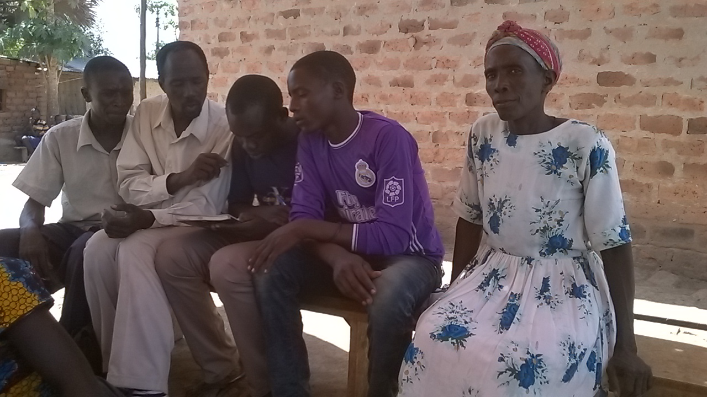
Can women groups be a tool for empowerment of women also if they involve a few men?
Right: Women welcoming the visitor with dance (Note En Teko 2017).
Below: Group discussion (Bung 2017)

Slide 16
Studytour to Farmers Family Learning Group in Rwenzori (SATNET and Organic Denmark). Facilitator Longino from SATNET explains.

Slide 17
Group discussion 2
Why do women groups in East Africa always include a few men, according to your understanding and experiences?
Would the East African women gain from forming separate groups (and the men from forming separate groups)?
Which advantages and disadvantages can the family groups have (Økologisk Landsforening)?

